Slide 1


CMR TECHNICAL CAMPUS UGC(AUTONOMOUS) Kandlakoya, Medchal Road, Hyderabad-501401, Telangana Department of Computer Science and Engineering Major Project On TWO FACTOR AUTHENTICATION VOTING SYSTEM BATCH NO : 05
PROJECT GUIDE:
Mrs.G.Kalpana Devi
Assistant Professor,CSE Department
BATCH MEMBERS:
T.Sai Prasanna 217R1A0559
V.Sai Prathap 217R1A0564

Slide 2
DEPARTMENT VISION AND MISSION
DEPARTMENT VISION:
To provide quality education and a conducive learning environment in computer engineering that foster critical thinking, creativity, and practical problem-solving skills.
DEPARTMENT MISSION:
To educate the students in fundamental principles of computing and induce the skills needed to solve practical problems.
To provide State-of-the-art computing laboratory facilities to promote industry institute interaction to enhance student’s practical knowledge.
To inculcate self-learning abilities, team spirit, and professional ethics among the students to serve society.

Slide 3
CONTENTS
Abstract
Introduction
Existing system
Disadvantages of existing system
Proposed system
Advantages of proposed system
Hardware and software requirements
Novelty
Architecture
Modules
UML Diagrams
Sample Code
Result
Conclusion
Future Scope
References
Github Link

Slide 4
ABSTRACT
The system integrates multiple authentication factors, such as biometrics and smart cards, to prevent voter impersonation and unauthorized access.
Fingerprint biometrics and cryptographically secured smart cards ensure robust voter verification.
The use of multi-factor authentication helps mitigate risks like vote-rigging, vote falsification, and unauthorized voting.
The system ensures that the final vote count accurately represents the true will of the voters.
By requiring multiple verification factors, such as something they know, have, or are, the system strengthens election security against cyber threats and unauthorized access.

Slide 5
INTRODUCTION
Electronic voting systems improve efficiency and accessibility but face security challenges like vote-rigging and voter impersonation.
Two-factor authentication (2FA) enhances security by requiring two verification factors, such as a PIN and biometric identifier.
Blockchain-based mobile voting systems combined with 2FA ensure secure vote storage and voter authentication.
Real-world implementations, like Vero Voting, use 2FA through unique IDs, PINs, and mobile verification codes.
Guidelines like VVSG 2.0 advocate for multi-factor authentication to protect voting infrastructure and uphold electoral integrity.

Slide 6
EXISTING SYSTEM
Traditional voting relies on paper ballots and manual vote counting, making the process time-consuming and error-prone.
Logistical challenges, high costs, and risks of ballot tampering or misplacement affect the reliability of the system.
Manual vote counting is vulnerable to fraud, including multiple voting, miscounting, and manipulation by officials.
Electronic voting machines (EVMs) offer automation but raise concerns over transparency and verifiability.
Physical identity verification in traditional voting can be bypassed through impersonation or forged documents, highlighting the need for a more secure system.

Slide 7
DISADVANTAGES OF EXISTING SYSTEM
Time-Consuming Process
Security and Fraud Risks
High Operational Costs
Limited Accessibility
Lack of Transparency

Slide 8
PROPOSED SYSTEM
Utilizes blockchain technology to ensure a decentralized, tamper-proof, and immutable voting record.
Incorporates biometric authentication and multi-factor verification to prevent voter fraud and unauthorized access.
Enables secure remote electronic voting via a web-based or mobile application, ensuring accessibility and data integrity.
Implements real-time vote tallying and verification to enhance accuracy and eliminate manual counting errors.
Strengthens voter trust by addressing security risks, improving transparency, and providing a seamless election experience.

Slide 9
ADVANTAGES OF PROPOSED SYSTEM
Enhanced Security
Elimination of Voter Fraud
Improved Accessibility
Faster and Accurate Vote Counting
Tamper-Proof and Transparent Elections

Slide 10

REQUIREMENTS SPECIFICATION
HARDWARE REQUIREMENTS :
Processor : i5
Hard disk : minimum of 20 GB
RAM : minimum of 4 GB

Slide 11
SOFTWARE REQUIREMENTS :
Operating System : Windows 10
Coding Language : Python 3.7v
Front-End : Python
Back-End : Django-ORM
Designing : Html, css, javascript.

Slide 12
NOVELTY
Leverages blockchain technology for a decentralized, immutable, and tamper-proof vote recording system, enhancing security and transparency.
Implements biometric authentication, including fingerprint and facial recognition, combined with multi-factor authentication (MFA) using OTP or smart cards to prevent voter impersonation and fraud.
Enables secure remote voting through a web-based or mobile application, ensuring accessibility while maintaining data integrity and confidentiality.
Incorporates real-time vote tallying and verification to eliminate manual counting errors, reduce delays, and prevent manipulation.
Aligns with security guidelines from VVSG 2.0 and employs advanced encryption protocols to safeguard voter credentials and election data.

Slide 13
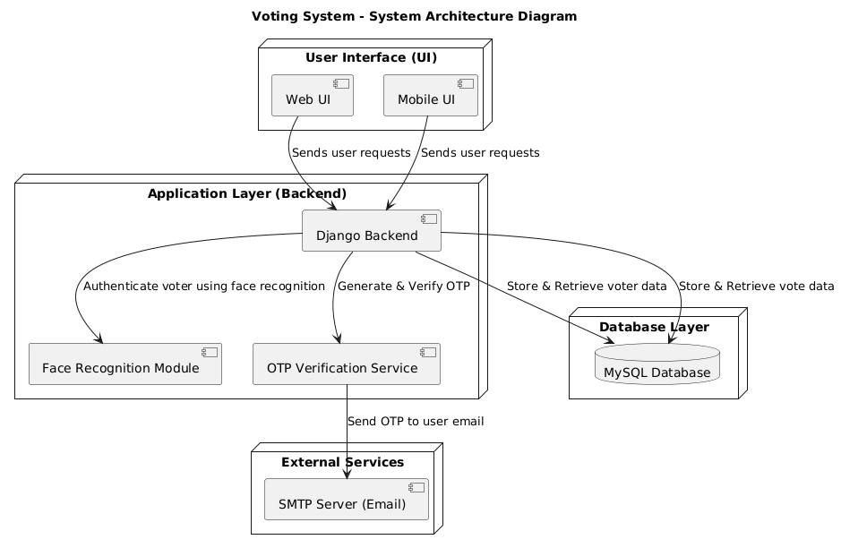
ARCHITECTURE

Slide 14
MODULES
In this project as per your requirements we have designed following modules
Admin module: admin can login to system using username and password as ‘admin and admin’. After login admin will add new party details along with symbols. Admin will add voter details by capturing information like AADHAR number, thumb image, email, phone number and then capture users photo. Admin can view all part details and can view vote count for each party
User Module: user can login to system by using username, AADHAR number and thumb image. If all this details matched then OTP will be forward to user registered mail. After OTP validation user will be forward for face capturing and recognition. Once face recognized then user will be forward to cast vote by displaying various parties. User can cast his vote to desired party.

Slide 15
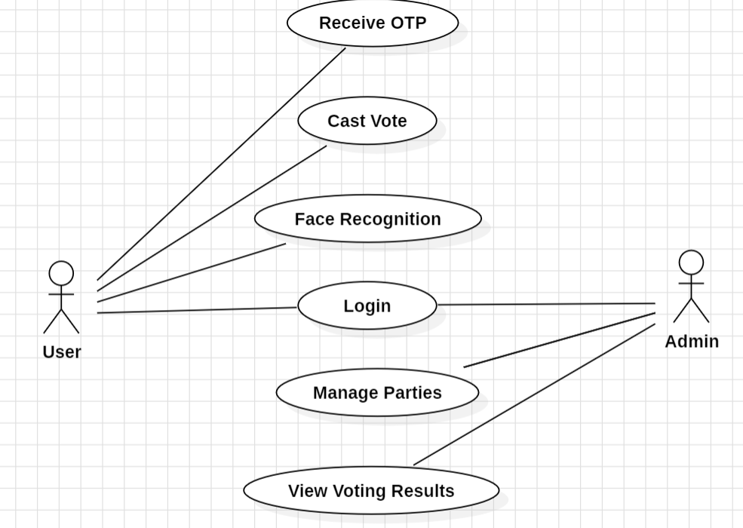
UML DIAGRAMS
USECASE DIAGRAM

Slide 16
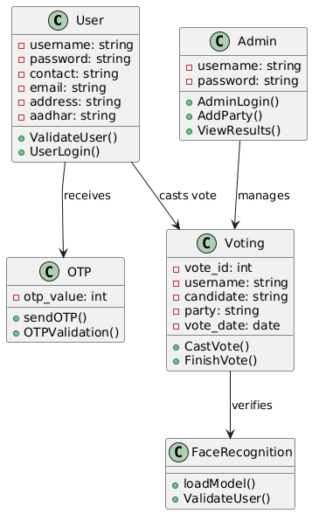
CLASS DIAGRAM

Slide 17
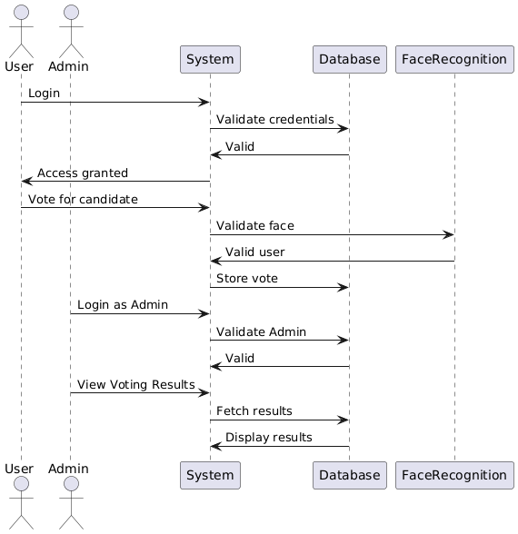
SEQUENCE DIAGRAM

Slide 18
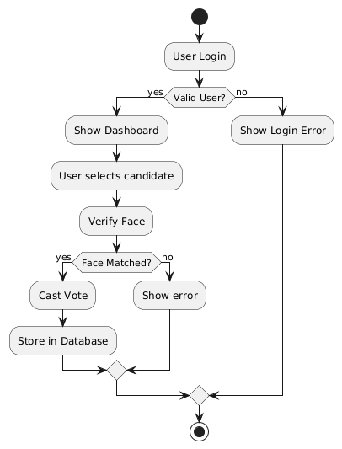
ACTIVITY DIAGRAM

Slide 19
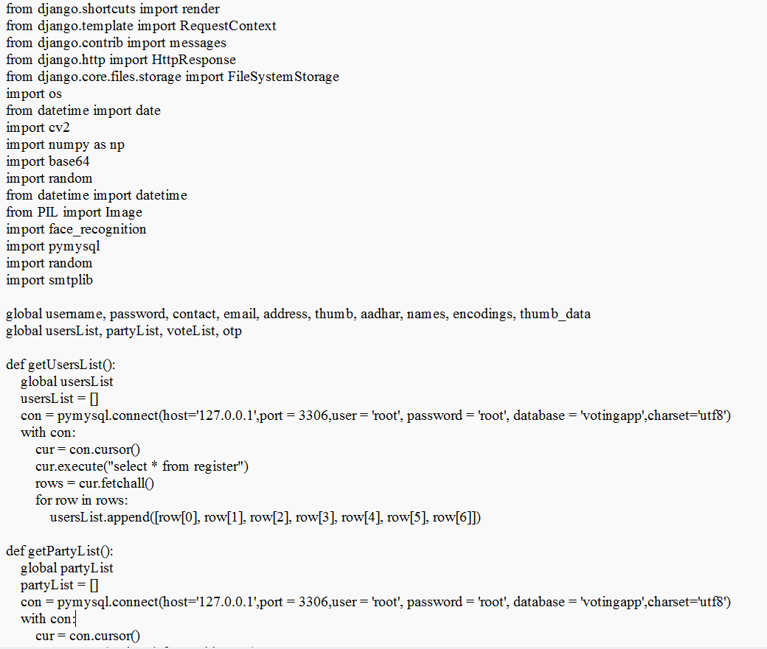
SAMPLE CODE

Slide 20
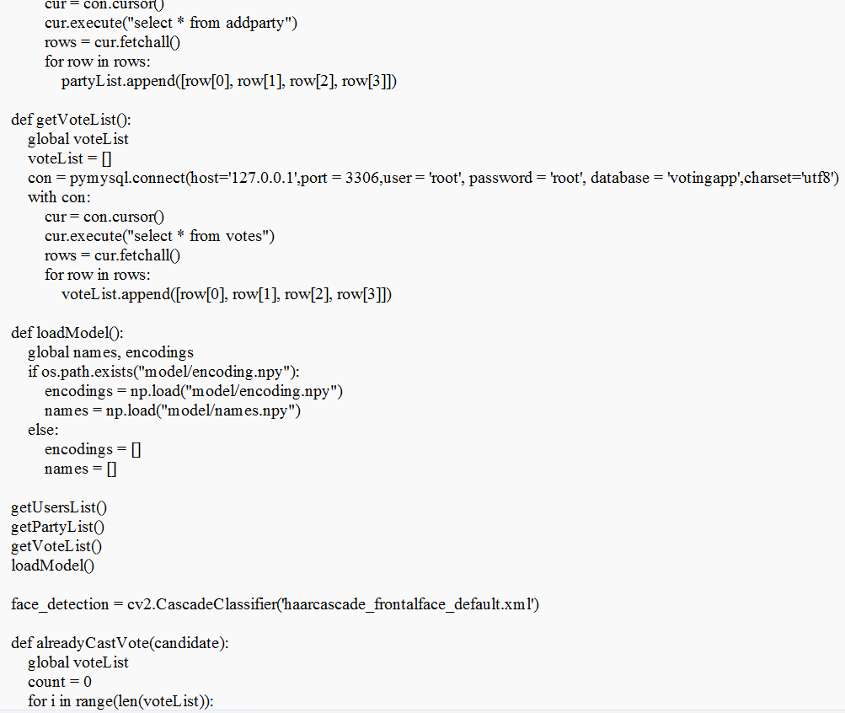

Slide 21
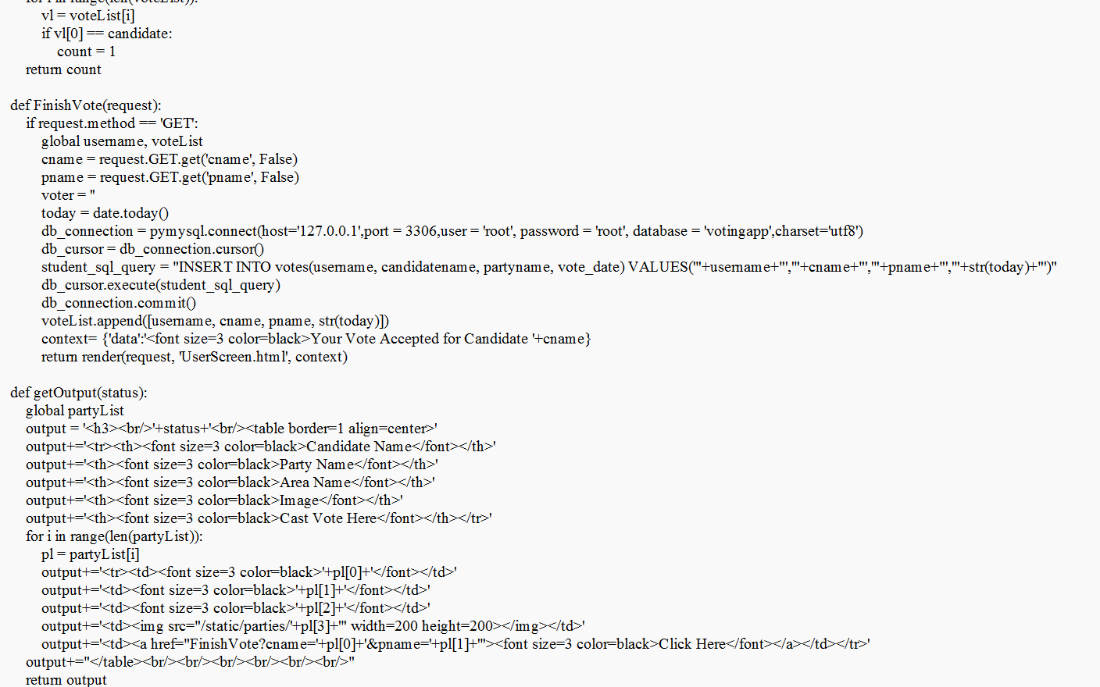

Slide 22
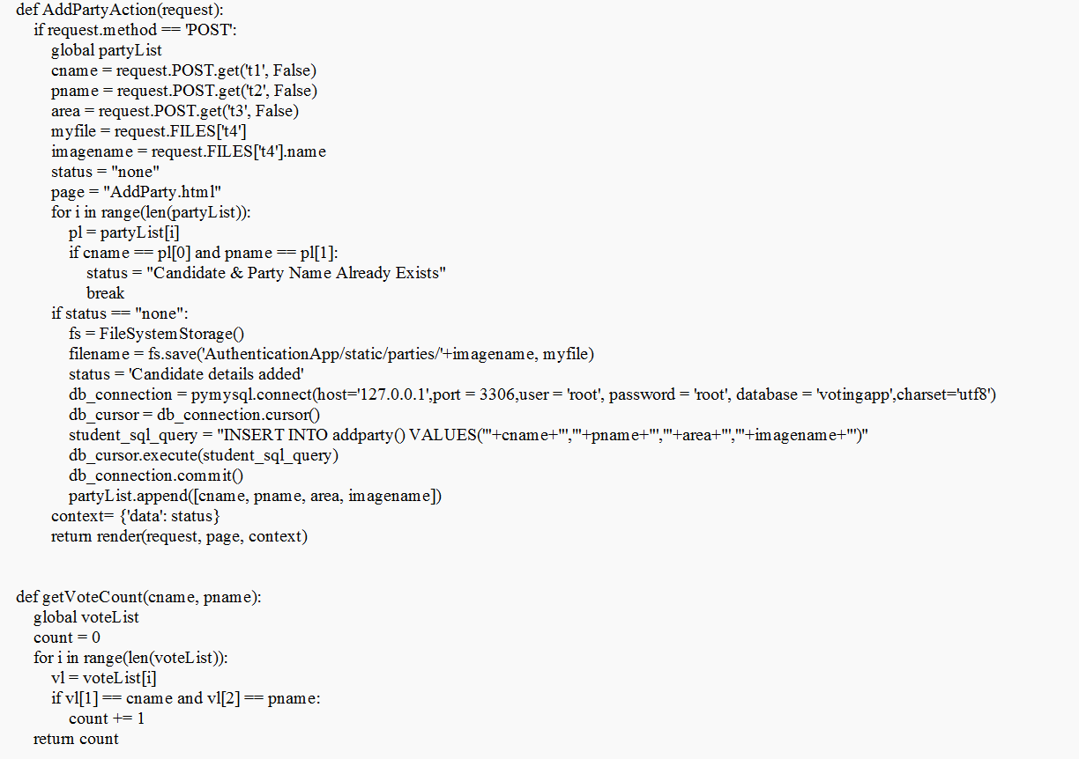

Slide 23
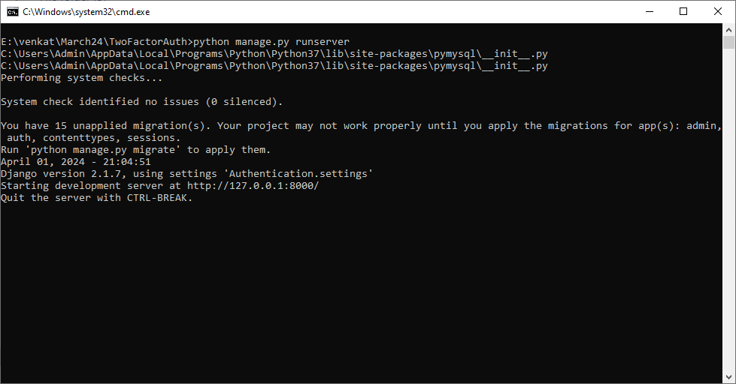
RESULTS

Slide 24

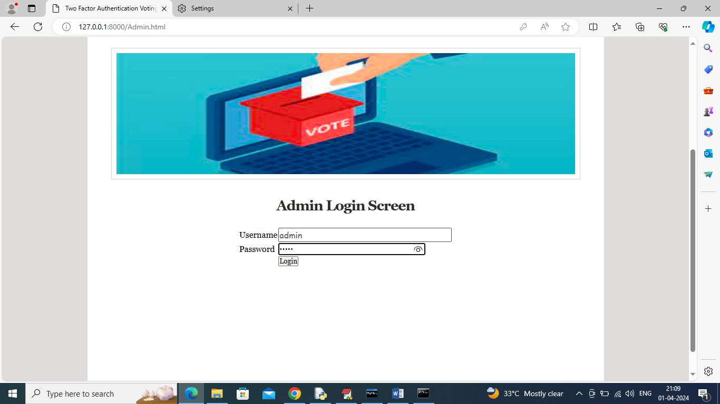

Slide 25
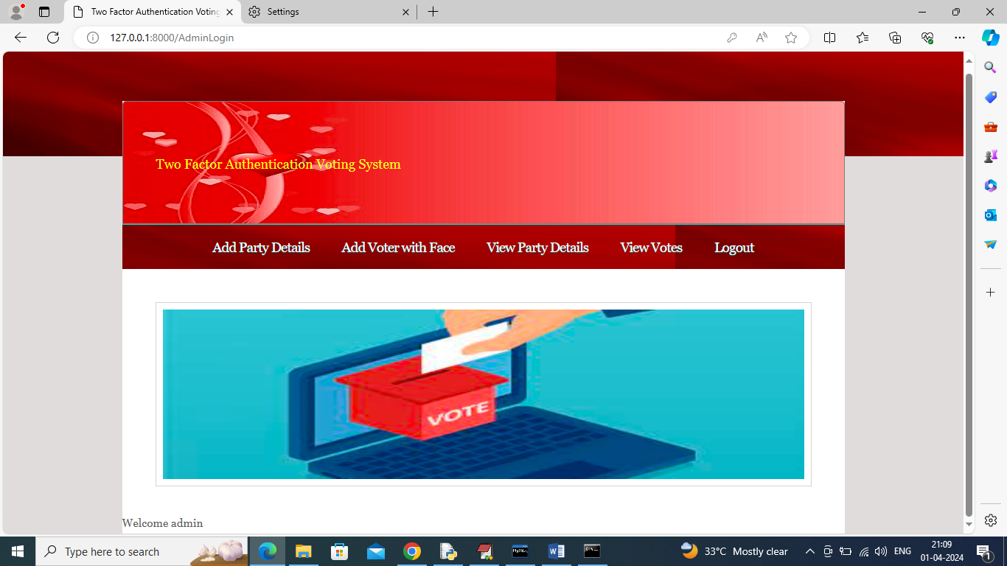
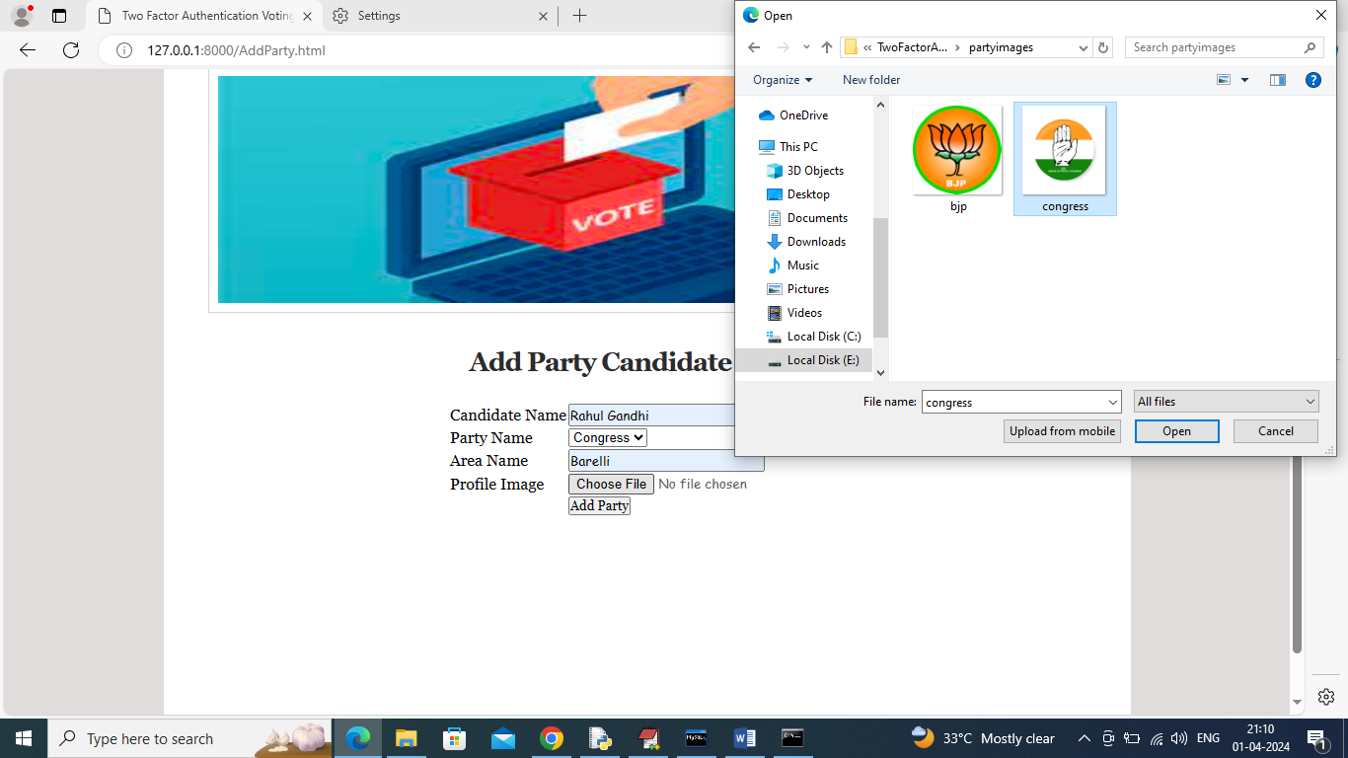

Slide 26
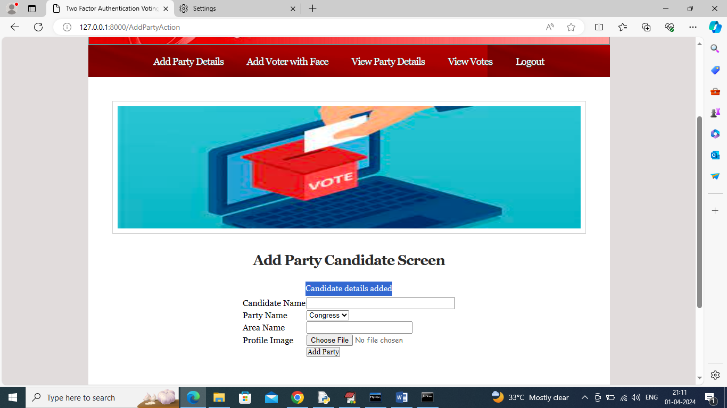
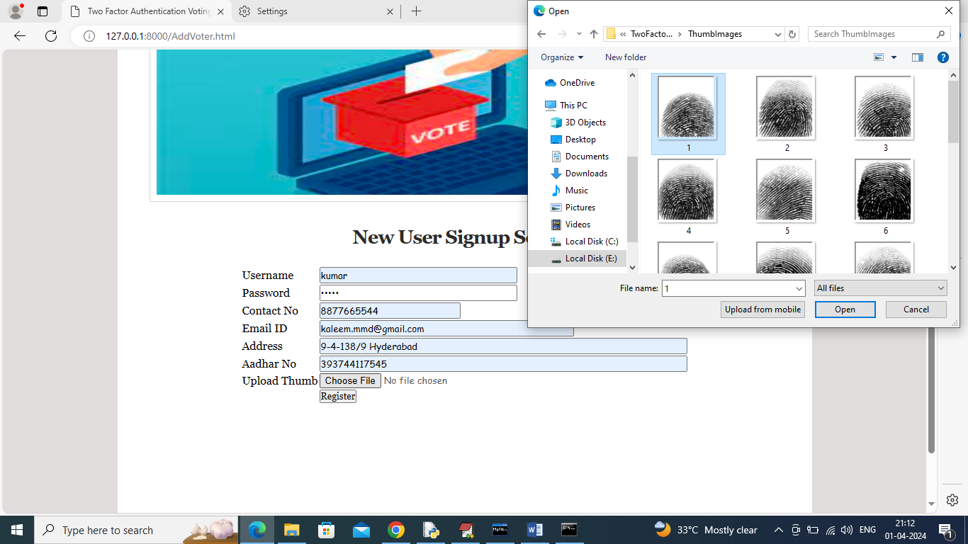

Slide 27
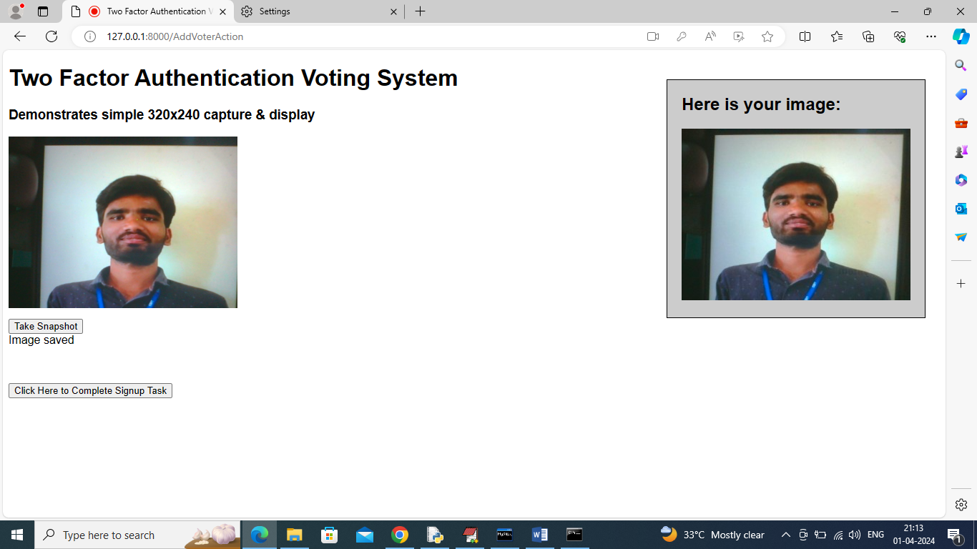
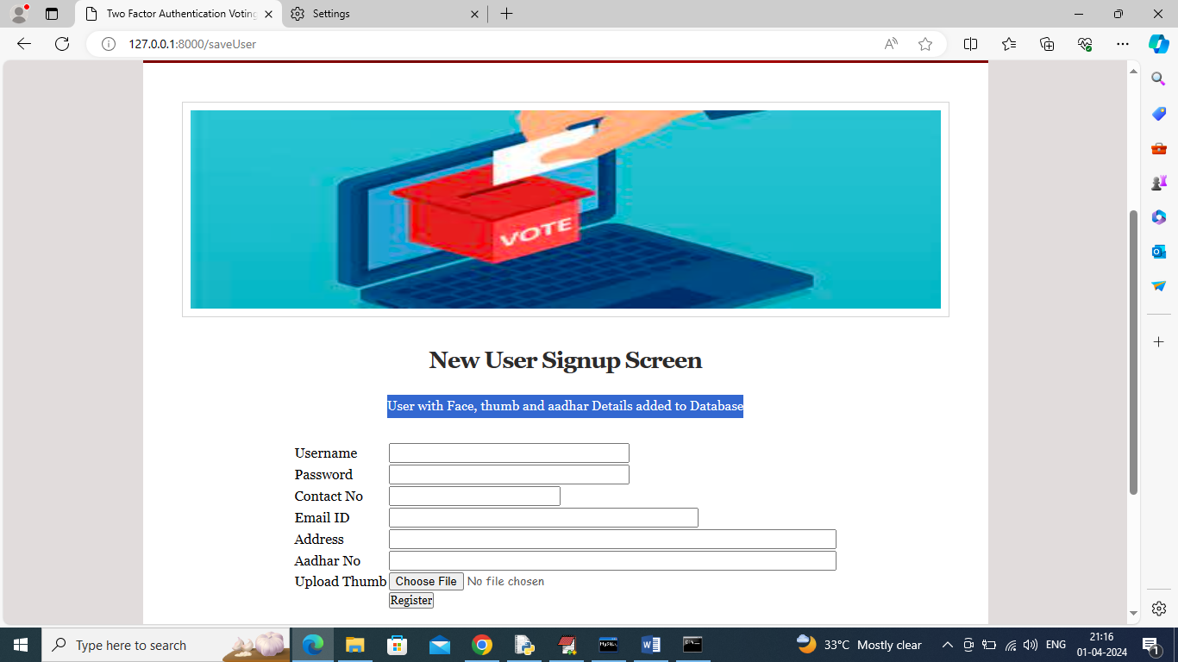

Slide 28
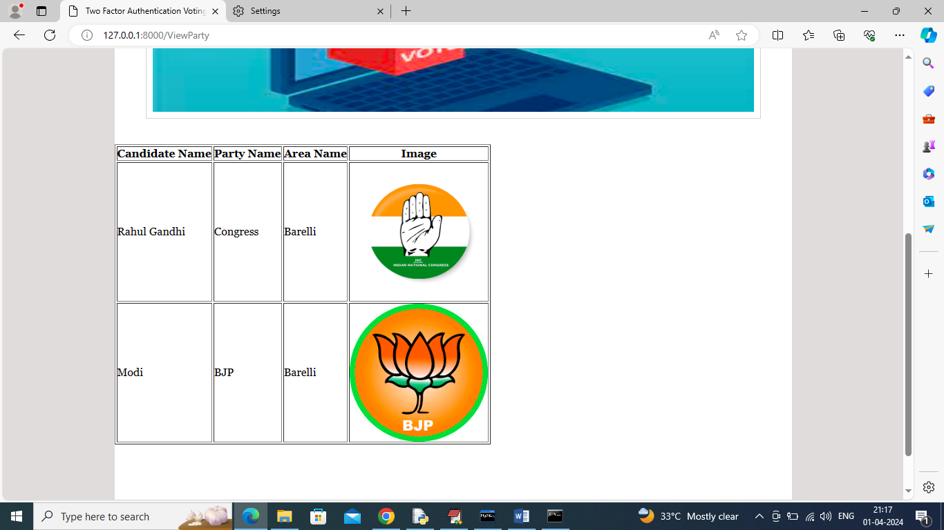
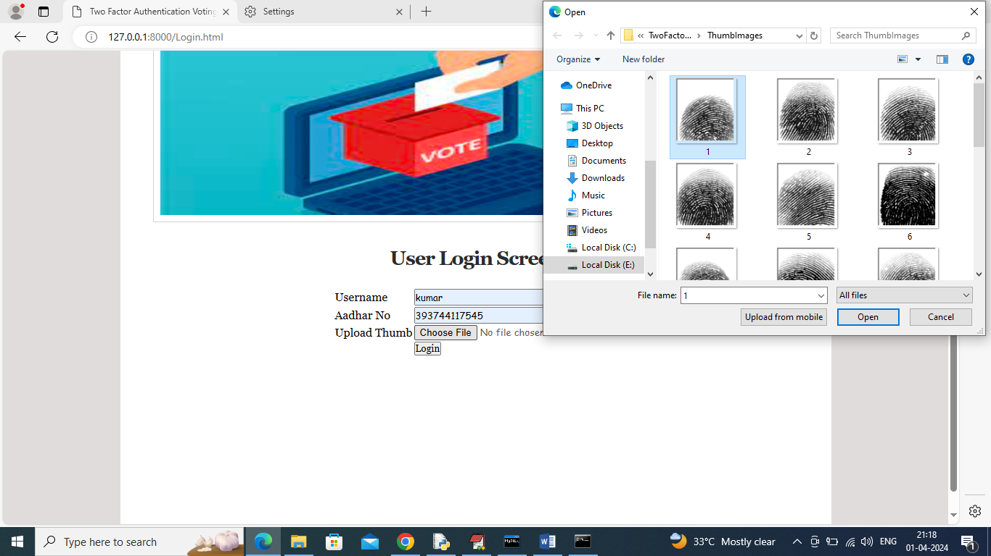

Slide 29
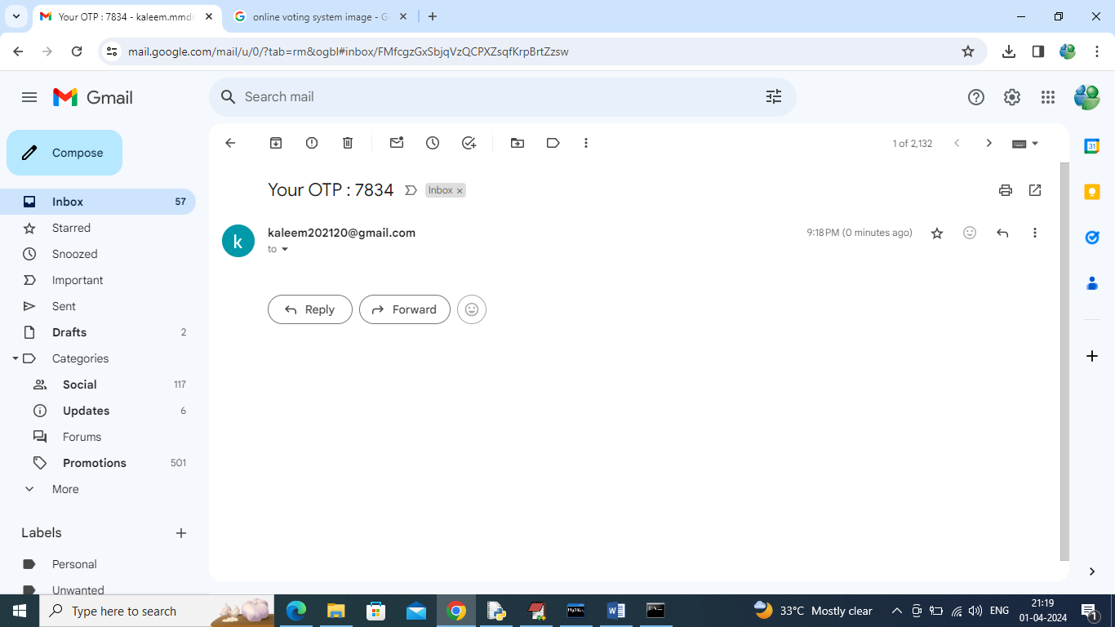
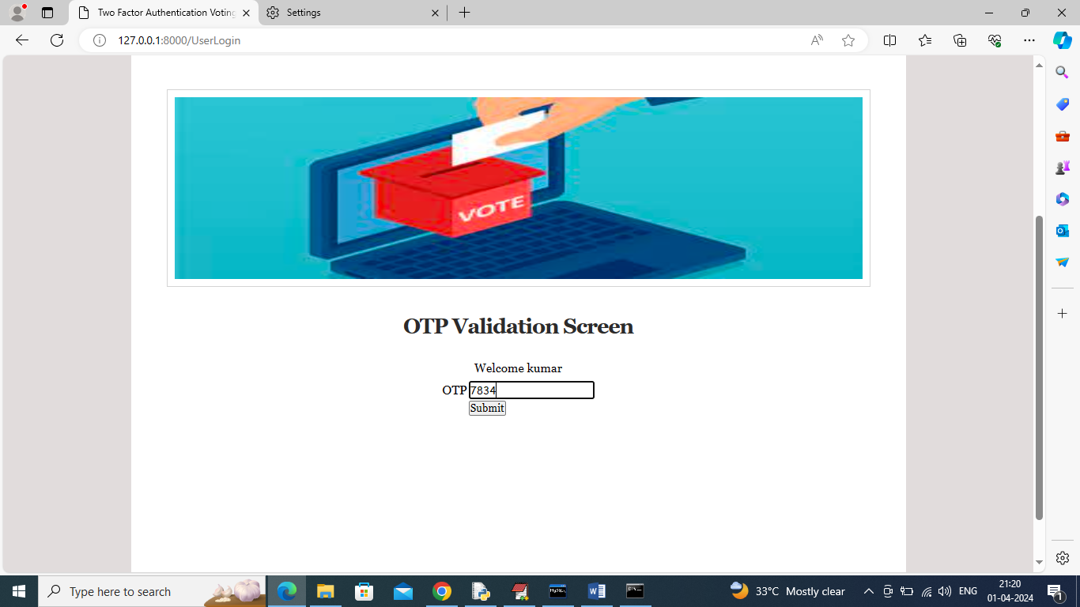

Slide 30
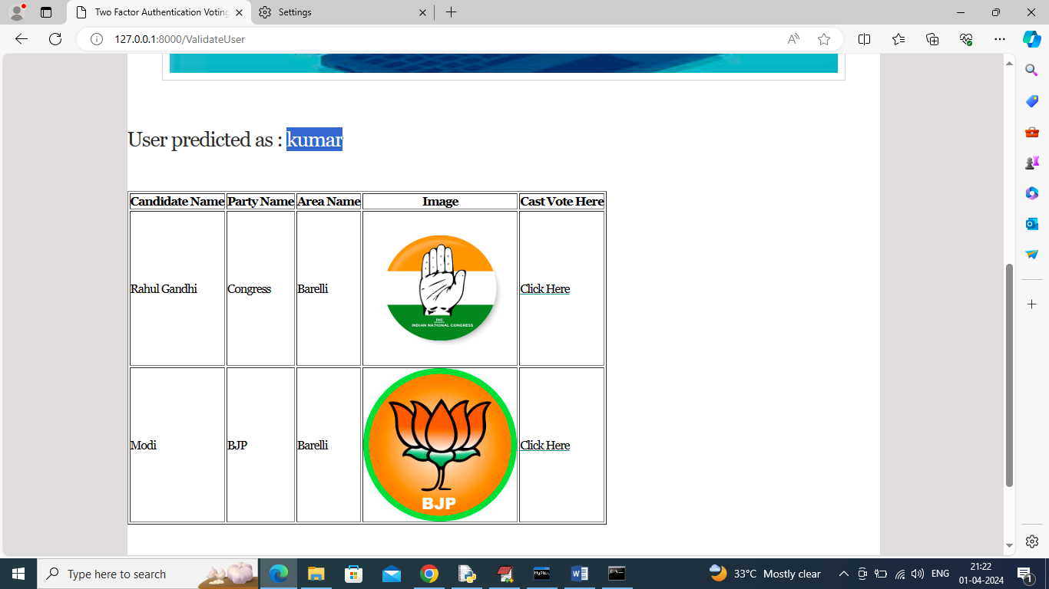
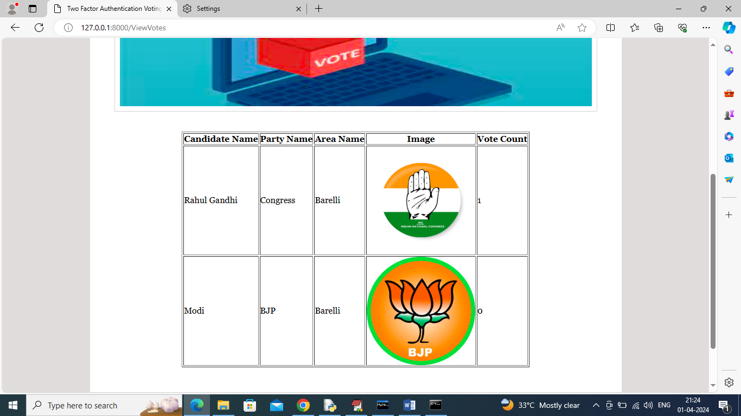

Slide 31
CONCLUSION
Integrates advanced security mechanisms to address limitations of traditional voting methods.
Utilizes blockchain, biometric authentication, and encryption to prevent voter fraud, tampering, and result manipulation.
Enables real-time vote counting and remote accessibility to enhance efficiency and voter participation.
Enhances the reliability, security, and transparency of the electoral process.
Future research and development can further improve adoption and ensure a seamless democratic voting experience.

Slide 32
FUTURE SCOPE
Integration of blockchain, artificial intelligence, and homomorphic encryption to enhance security and prevent vote manipulation.
AI-driven fraud detection by identifying anomalies in voting patterns.
Biometric authentication methods like facial recognition and fingerprint scanning to strengthen voter verification.
Improved accessibility for remote voters, including overseas citizens and individuals with disabilities, through mobile and cloud-based platforms.
Implementation of decentralized and verifiable audit mechanisms to enhance public trust in election outcomes.
Continuous refinement of security protocols and accessibility to establish electronic voting as the standard for democratic elections worldwide.

Slide 33
REFERENCES
Rivest, R. L. (2001). Electronic voting. Proceedings of Financial Cryptography, Springer.
Rubin, A. D. (2002). Security considerations for remote electronic voting. Communications of the ACM, 45(12), 39-44.
Kohno, T., Stubblefield, A., Rubin, A. D., & Wallach, D. S. (2004). Analysis of an electronic voting system. IEEE Symposium on Security and Privacy, 27-40.
Volk, C., & Preneel, B. (2019). Blockchain for electronic voting: A systematic literature review. IEEE Transactions on Blockchain, 2(3), 324-336.
U.S. Election Assistance Commission. (2021). Voluntary Voting System Guidelines (VVSG 2.0). U.S. Election Assistance Commission Report.

Slide 34
GITHUB LINK
https://github.com/Sai-prasanna559/Two-Factor-Authentication-Voting-System

Slide 35
THANK YOU

